Slide 1
Collections

Slide 2
Version Control and Revision History
 | Name | Date
Prepared By | Paranthaman | 09-07-2019
Reviewed By | Team | 09-07-2019
Approved By | Team | 09-07-2019
Version No. | Date | Affected Sections | Highlights
2.0.0 |  | ALL | Updated Based on the course sheet coverage

Slide 3

Objective
To understand the concept of Java collections framework Which gives the programmer
access to prepackaged data structures as well as to algorithms for manipulating them.
Use Generics
Notes:
It should be mentioned to the participant that current version of Java is 1.5, although not covered as part of this training.

Slide 4
Collections
What are Collections?
A Collection is a group of objects represented as a single unit.
Collections Framework
Collections framework provide a set of standard utility classes to manage collections.
Defined within java.util package.
Collections Framework consists of three parts:
Core Interfaces:
Concrete Implementation
These are the concrete implementations of the collection interfaces.
In essence, they are reusable data structures.
Algorithms:
These are the methods that perform useful computations, such as searching and sorting, on objects that implement collection interfaces.

Slide 5
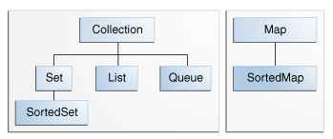
Collections
Core Interfaces:
These are abstract data types that represent collections. Interfaces allow collections to be manipulated independently of the details of their representation.
There are two groups of interfaces Collection and Map

Slide 6
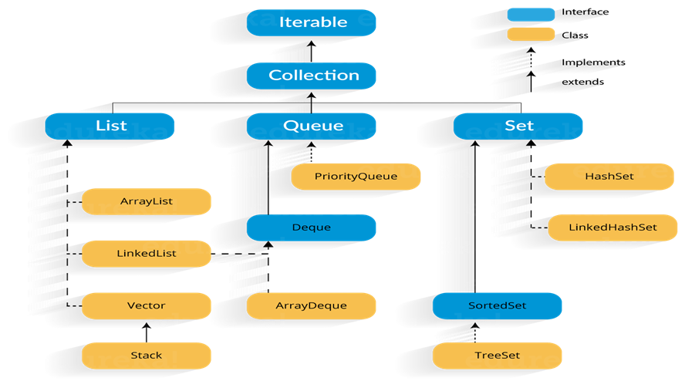
Collections - Implementations

Slide 7
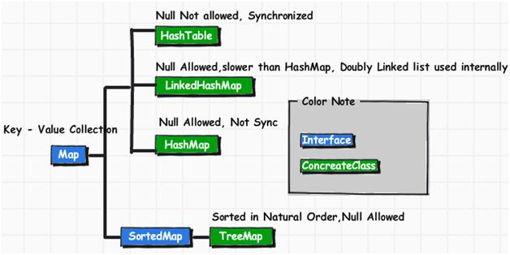
Collections – Map Implantations

Slide 8
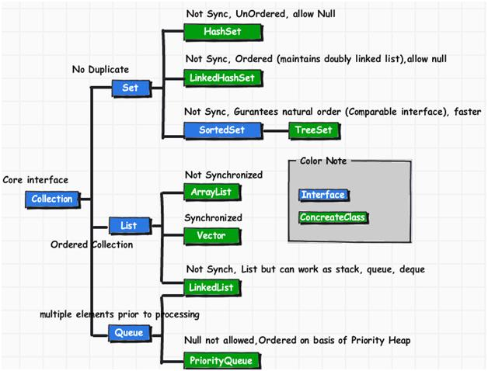
Collections – Implementation Classes

Slide 9
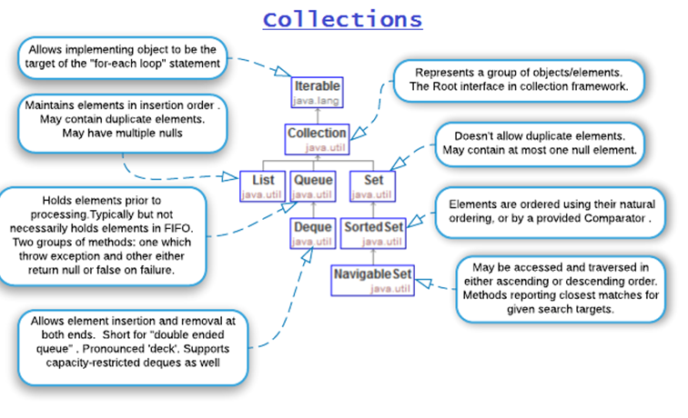
Collections

Slide 10
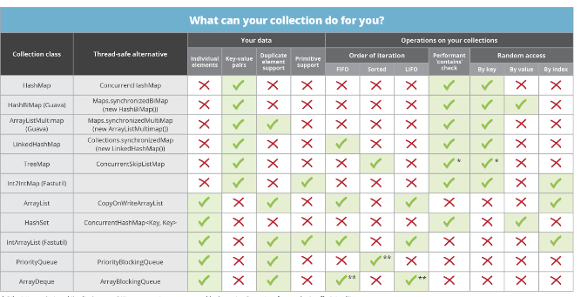
Collections

Slide 11
Collections
List Interface:
Elements are ordered and may contain duplicates
Have indexable elements (using zero-based indexing).
Elements are kept ordered sequence (which often depends on the order that we added them).
There are 4 main List implementations:
Vector
a general kind of list with many useful accessing/modifying/searching methods
a synchronized class
ArrayList
also general like Vectors
an unsynchronized class (faster than Vectors)
It is re-sizable array implementation
LinkedList
methods for double-ended access, no direct access from the middle
Stack
accessible from one end only (the top).

Slide 12
Collections
Set Interface:
It represents set of objects, meaning each element can only exists once in a Set.
It contains only methods inherited from Collection interface
The Set Implementations are:
HashSet:
Stores its elements in a hash table.
This class permits the null element
LinkedHashSet
implements both the Hash table and linked list implementation of the Set interface.
This implementation differs from HashSet that it maintains a doubly-linked list.
The orders of its elements are based on the order in which they were inserted.
TreeSet
useful when you need to extract elements from a collection in a sorted manner.
The elements added to a TreeSet are sortable in an order.

Slide 13
Collections
SortedSet Interface:
Extends the Set interface.
Internally maintains its elements in sorted order.
The order of the sorting is either the natural sorting order of the elements or the order determined by a Comparator .
Only one implementation of the SortedSet interface – the TreeSet class.

Slide 14
Collections
Queue Interface:
Represents an ordered list of objects just like a List.
Ordering of elements in a FIFO (first-in-first-out) manner.
Designed to have elements inserted at the end of the queue, and elements removed from the beginning of the queue.
The Queue implementations are:
LinkedList
PriorityQueue
We can peek at the element at the head of the queue without taking the element out of the queue using the element() method.

Slide 15
Collections
The Map Interface:
Not a subtype of the Collection interface
Represents a mapping between a key and a value.
Also referred to as associative array or a dictionary
Has its own set of methods
Methods for adding and deleting
put(Object key, Object value)
remove (Object key)
Methods for extraction objects
get (Object key)
Methods to retrieve the keys, the values, and (key, value) pairs
keySet() // returns a Set
values() // returns a Collection,
entrySet() // returns a set

Slide 16
Collections
Map Interface(Contd..)
Most common Map implementations are:
HashMap
The implementation is based on a hash table except that it is unsynchronized and permits null.
No ordering on (key, value) pairs.
TreeMap
useful when you need to traverse the keys from a collection in a sorted manner.
(key, value) pairs are ordered on the key.
LinkedHashMap
implemented using both Hash table and linked list implementation of the Map interface.
implementation differs from HashMap that maintains a doubly-linked list running through all of its entries in it.
orders of its elements are based on the insertion-order.

Slide 17
Collections
SortedMap Interface
SortedMap interface extends the Map interface.
Special Map interface for maintaining elements in a sorted order.
Similar to a SortedSet except, the sort is done on the map keys.
In addition to methods of the Map interface, it provides two methods shown as:
firstKey( ):
returns the first (lowest) value currently in the map
lastKey( ) :
returns the last (highest) value currently in the map

Slide 18
Collections
Solution: Generics(introduced in Java5)
Tell the compiler type of the collection
Let the compiler fill in the cast
Example: Compiler will check if you are adding Integer type entry to a String type collection (compile time detection of type mismatch)
Generics abstract over Types
Classes, Interfaces and Methods can be Parameterized by Types
Generics provide increased readability and type safety
If it compiles without any errors or warnings, then it must not raise any unexpected ClassCastException during runtime

Slide 19
Collections
Generics(Contd…):
To Declare a generic class replace type parameter <E> with concrete type argument, like <Integer> or <MyType>
E.g.
LinkedList<Integer> li =new LinkedList<Integer>();
li.add(new Integer(0));
Integer i = li.iterator().next();
In the above example LinkedList<E> has a type parameter E that represents the type of the elements stored in the list.
LinkedList<Integer> can store only Integer or sub-type of Integer as elements

Slide 20
Collections
Generics(Contd..):
Generic class can have multiple type parameters
Type argument can be a custom type
E.g.
HashMap<String, Mammal> map = new HashMap<String,Mammal>();
map.put(“wombat”, new Mammal("wombat"));
Mammal w = map.get(“wombat”);

Slide 21
Diamond Operator (Java 7)
JDK versions prior to 7.0 required declaring the types on both sides while declaring a variable using Generics.
Map<String, List<Sale>> sales= new TreeMap<String, List<Sale>> ();
In Java 7.0, you can write the above line of code like this,
Map<String, List<Sale>> sales= new TreeMap<> ();
You don’t have to type the whole list of Types in the right side for instantiation, instead you can use <> symbol, which is called diamond operator.

Slide 22
Collections
Comparable Interface:
Used to implement natural ordering of object.
Defined in java.lang package.
Has a method compareTo(Object o) for comparing
compareTo(Object o)
returns a negative integer, zero, or a positive integer as this object is less than, equal to, or greater than the specified object.
Compares "this" reference with the object specified.
If any class implement Comparable interface in Java then collection of that object either List or Array can be sorted automatically by using Collections.sort() or Array.sort() method and object will be sorted based on there natural order defined by CompareTo method.
In Java API String, Date and wrapper classes implement Comparable interface.

Slide 23
Collections
Comparator Interface:
Defined in java.util package.
Used to compare values of two objects and sort the objects with control.
specifies two methods:
compare(Object a, Object b)
returns a negative integer, zero, or a positive integer as a is less than, equal to, or greater than b
equals(Object o)
as in Object, used not to compare the stored values for value, but to determine if two comparator classes can be considered equal
Note that the behavior of the compare method should be consistent with equals, as Sun's documentation advises; that is, compare(a, b) should return 0 when a.equals(b) returns true

Slide 24
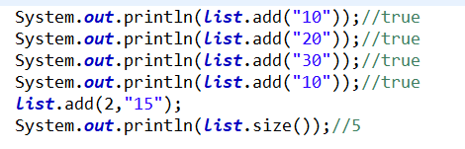
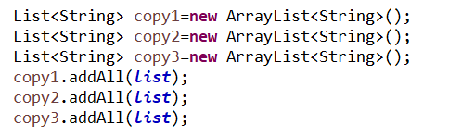
Collections – List with add methods

Slide 25
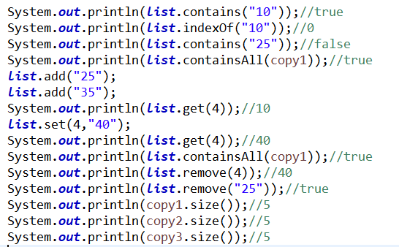
Collections – List with Other Methods methods

Slide 26
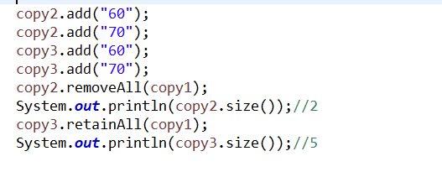
Collections – List with removeAll and retainAll methods

Slide 27
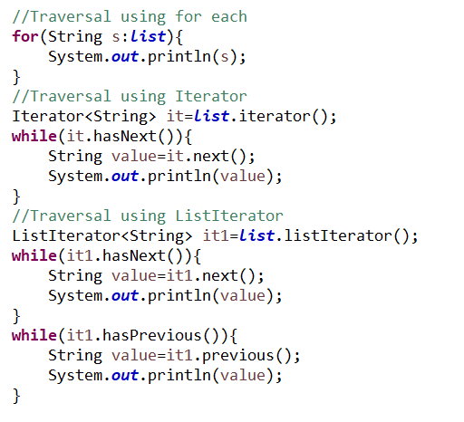
Collections – List with Traversal

Slide 28
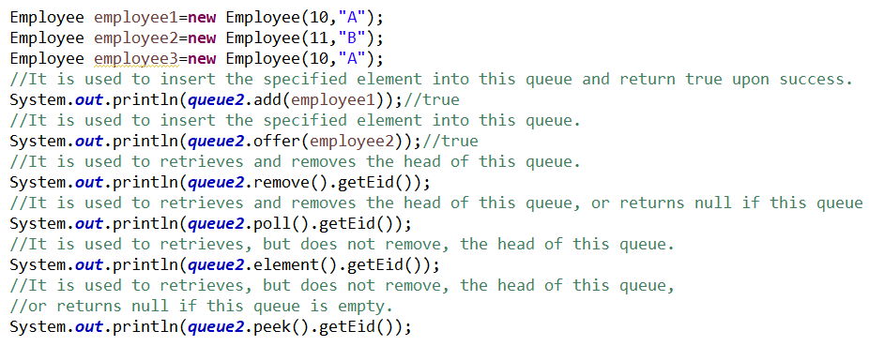
Collections – Queue with FIFO

Slide 29
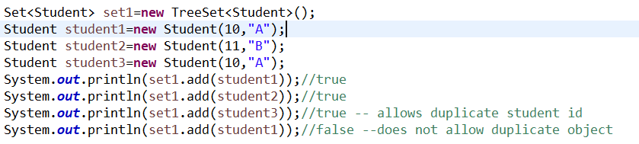
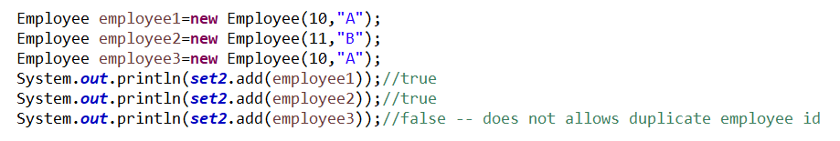
Collections – Treeset

Slide 30
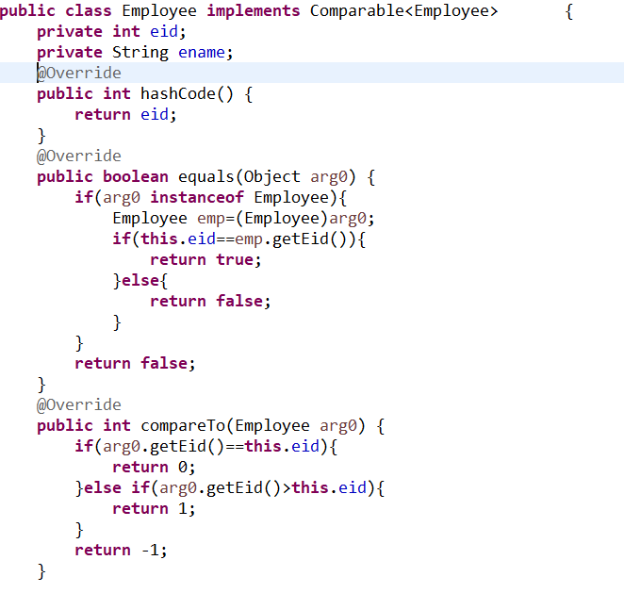
Collections – Comparable

Slide 31
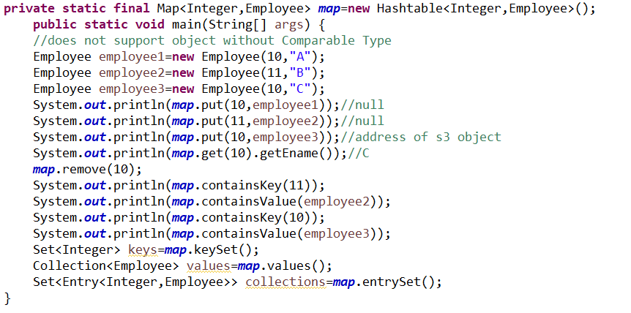
Collections – HashTable

Slide 32
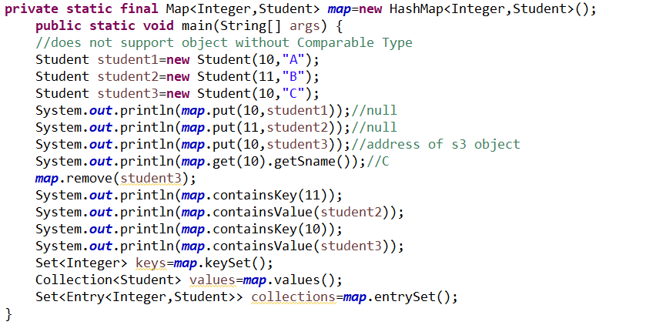
Collections – HashMap

